Slide 1
Regulation of Blood Glucose Dr.Chithra V Department of Biochemistry

Slide 2
Importance of Glucose
Glucose is the preferred source of energy for most of the body tissue.
Brain cells derive energy mainly from glucose. So if there is any derangement occur to the supply of glucose to brain , brain damage may occur – life threatening condition.
So the regulation of blood glucose is very important

Slide 3
Normal blood glucose level is 70 -110 mg/dl in the fasting state.
This level is maintained by the balance between glucose entering and leaving the blood.
This balance is managed by hormones – mainly insulin & glucagon

Slide 4
Entry of glucose into blood
Depends on
Absorption of glucose from intestine
Glycogenolysis (breakdown of glycogen to glucose)
Gluconeogenesis
Hyperglycemic hormone – glucagon

Slide 5
Leaving of glucose from blood - Depletion
Depends on
Utilisation of glucose by tissues for energy
Glycogenesis – Synthesis of glycogen from glucose)
Lipogenesis – conversion of glucose to fat
Hypoglycrmic hormone - insulin

Slide 6
Regulation
Occurs at two levels
1) Post prandial regulation
2) Regulation in Fasting State

Slide 7
Post Prandial Regulation
After a meal,blood glucose level increases – secretion of insulin.
Insulin favours glucose uptake by
Increased peripheral utilisation of glucose – by glycogenesis and lipogenesis

Slide 8
Regulation in Fasting State
2 to 21/2 hours after a meal ,the blood glucose level falls below normal- stimulate the secretion of glucagon.
Glucagon increases blood glucose level by
Glycogenolysis
Gluconeogenesis

Slide 10
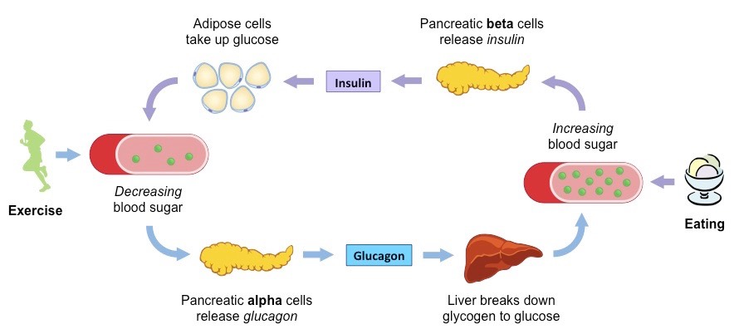
Blood glucose regulation in fasting state

